Slide 1
MEETING 13 ANSWER TRANSITION QUESTIONS

Slide 2
How to Determine the Question from the Reading Passage
Identifying the question
-> finding the specific information in the passage
Such as, the question “where” is used to indicate that this question is about finding specific information in the passage
Understanding where to find the answer
-> the answer could be in any lines listed in the answer choices

Slide 3
3 Steps of Answering the Questions
Choose the keywords of the question
Skim the only lines which listed in the answer choices
Choose the best answer that contains the line numbers of restatement of the keyword

Slide 4
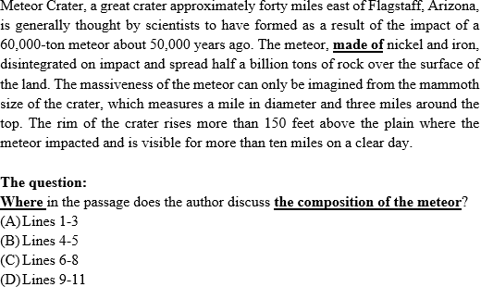
See IAE Module page 125

Slide 5
The question “where” and the keyword are about the composition of the meteor
The question asks to find information about the “composition” of the crater
Skim the lines which listed in the passage, such as line 1-3, line 4-5, line 6-8, and line 9-11
Find out the word “composition” or “something that means composition” by seeing the expression “made of”

Slide 6
Tone
To find out the author’s emotion in the passage
No showing emotion -> informative, descriptive passage

Slide 7
How to Answer this type question?
Skim the passage by find out the words that show author’s emotion
No contain any emotion → presenting the facts

Slide 8
Purpose
To draw the conclusion or the goal of the passage
How to answer it?
study the main idea in the topic sentence
Study the supporting main idea and draw conclusion

Slide 9
Adverb of Place
Adverb of place is used when to know the answer to a question that begins with where or where. This description will explain events related to the place (place).
Examples:
I carry that with me wherever I go.
I'll be digging our time capsule somewhere in the woods.

Slide 10
Course
Having similar way like finding out the author’s purpose
Counting on main idea and supporting of main idea

Slide 11
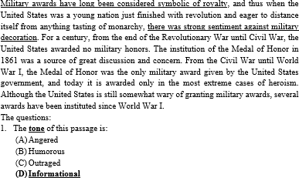
See IAE Module page 126

Slide 12
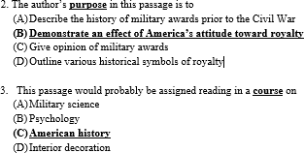
See IAE Module page 127

Slide 13
Question No 1
Asking about the tone of passage
How to Answer?
Skim the passage and find out the author’s emotion
The author presents the historical facts by using the expression of time: in 1861 and since WW1
So, the tone of passage is just informational and the correct answer is D

Slide 14
Question No 2
To determine the author’s purpose
Need to study the main idea of the passage → The main idea of the passage is about strong sentiment against military awards in the US
The word “sentiment” is considered as attitude
So, the purpose of this passage is to explain or demonstrate about America’s attitude toward royalty because military award is considered as royalty
Thus, the correct answer is B

Slide 15
Question No 3
It is about the course
You need to study main idea
The time expression is about present historical facts such as this century, after WW1
So, it can conclude that the passage is about history subject, specifically American History. Then, the correct answer is C

Slide 16
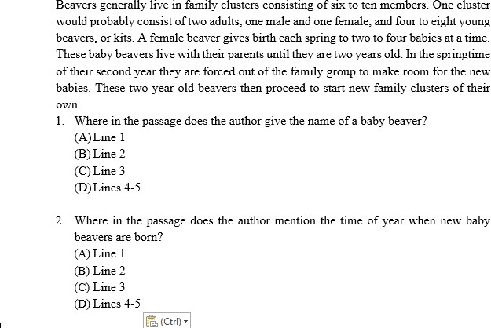
EXERCISE: Determine where specific information is found

Slide 17
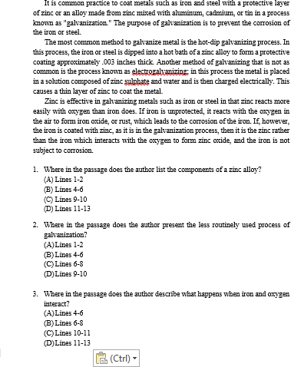

Slide 18
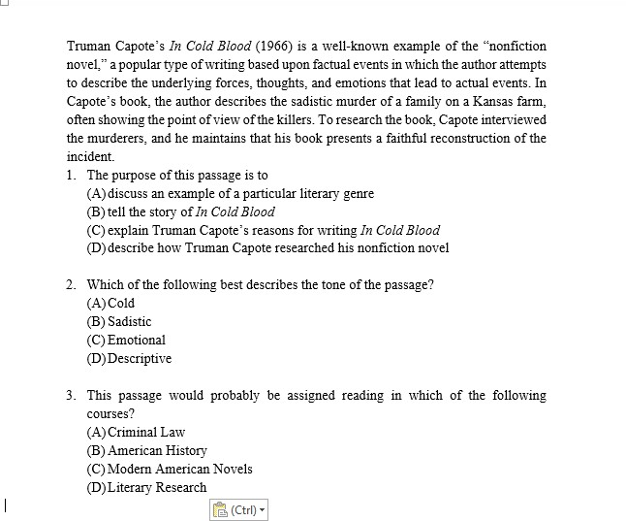
Exercise 2: Determine tone, purpose, and course

Slide 19
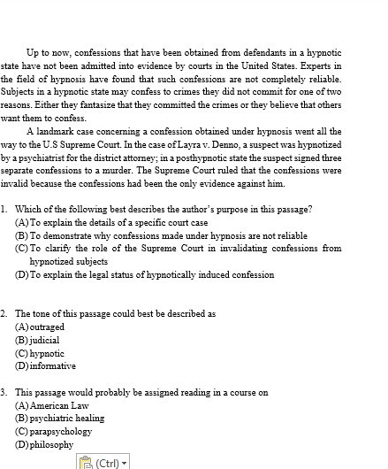

Slide 20
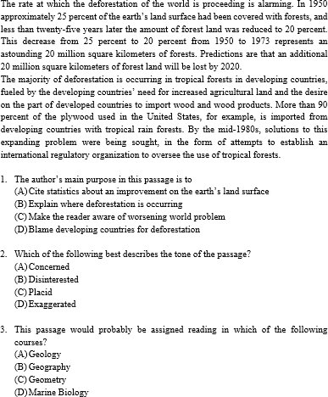

Slide 21


